Slide 1
Lecture 2a: A Recap of Economic Theory, Markets, and Willingness to Pay
Prof. Theising
Environmental Economics Econ 4075

Slide 2
Demand and Supply
A “market” for “something”…
Demand for something slopes downward… why?
If something is more expensive, the quantity demanded will be less
substitution
income
decreasing marginal benefit
Supply of something slopes upward… why?
As a “supplier” produces more of something it becomes more expensive to supply one more unit of that something
i) increasing marginal costs

Slide 3
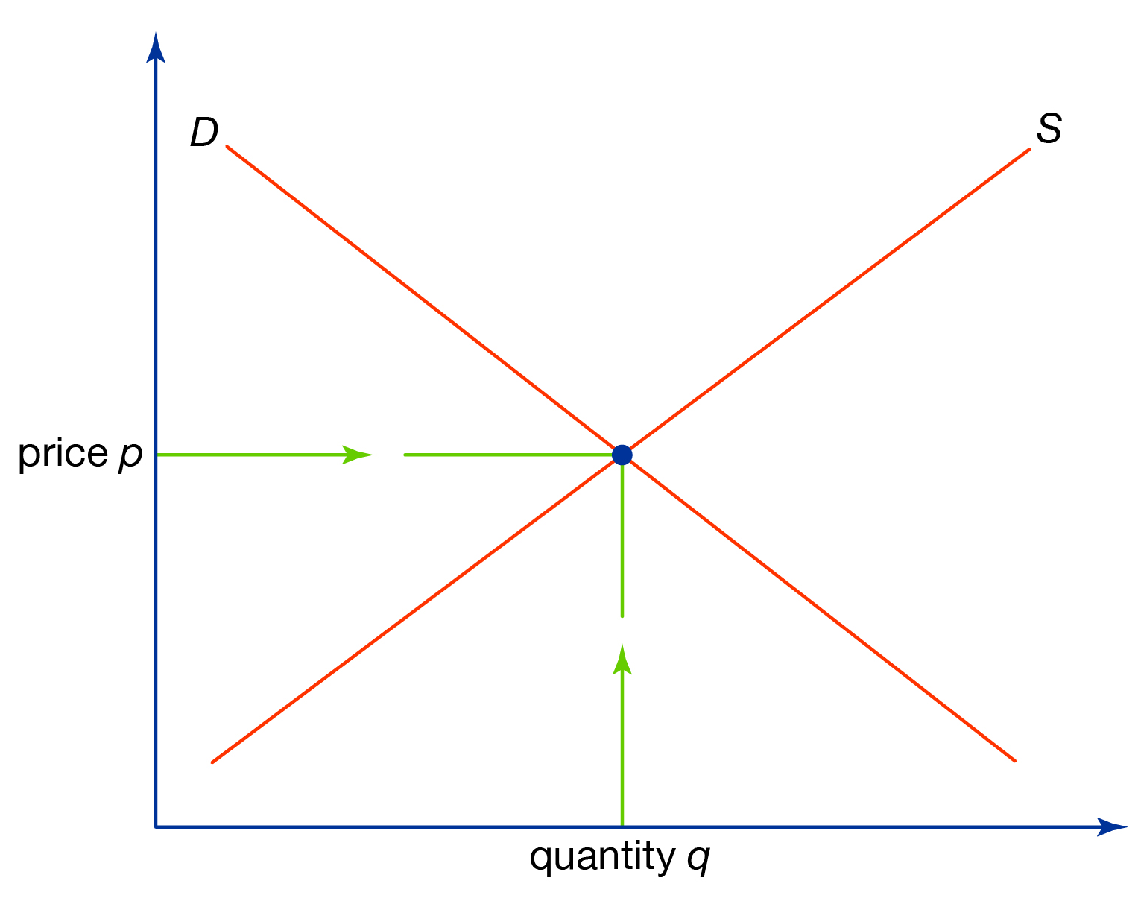
Demand and Supply
increasing marginal costs
decreasing marginal benefit

Slide 4
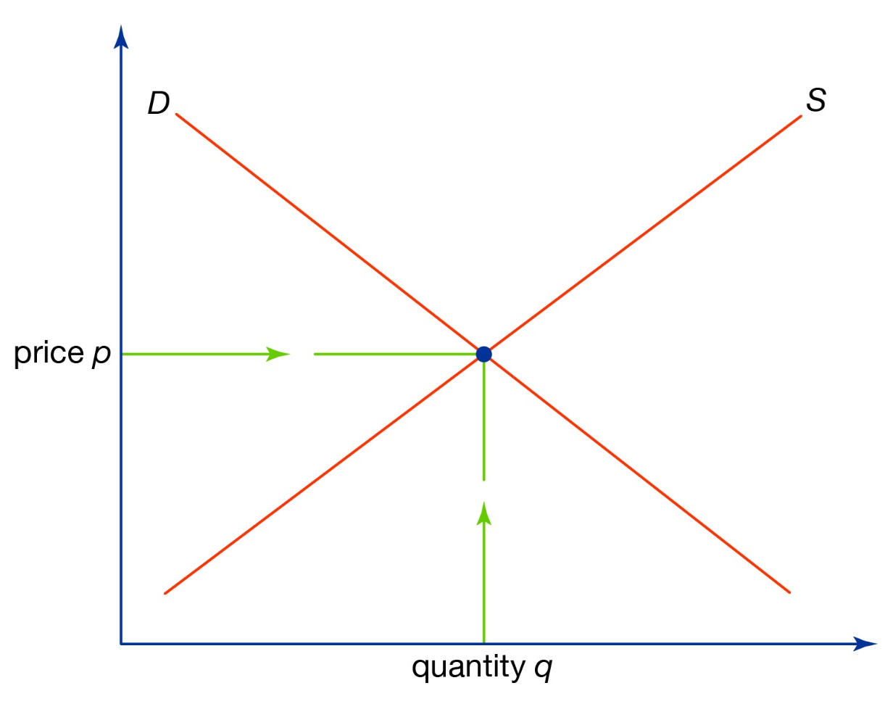

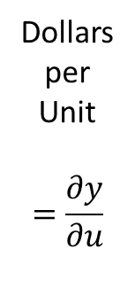
Demand
Total Benefits
Marginal Benefits
Dollars
per
Unit
$$=\frac{∂y}{∂u}$$
Dollars
= $Y$
Total
Benefit
Marginal
Benefit
Units
Units

Slide 5



Demand
Total Benefits
Marginal Benefits
Dollars
per
Unit
$$=\frac{∂y}{∂u}$$
Dollars
= $Y$
Total
Benefit
Slope of total
benefits line
$$y^{1}$$
Marginal
Benefit
$$u^{1}$$
Units
$$u^{1}$$
Units

Slide 6



Demand
Total Benefits
Marginal Benefits
Dollars
per
Unit
$$=\frac{∂y}{∂u}$$
Dollars
= $Y$
Total
Benefit
$$y^{2}$$
Slope of total
benefits line
Marginal
Benefit
$$u^{2}$$
Units
$$u^{2}$$
Units

Slide 7
Supply
Total Costs
Marginal Costs
Dollars
per
Unit
$$=\frac{∂y}{∂u}$$
Dollars
= $Y$
Marginal
Costs
Total
Costs
Units
Units

Slide 8

Supply
Total Costs
Marginal Costs
Dollars
per
Unit
$$=\frac{∂y}{∂u}$$
Dollars
= $Y$
Marginal
Costs
Slope of total
costs line
Total
Costs
$$y^{1}$$
$$u^{1}$$
$$u^{1}$$
Units
Units

Slide 9


Supply
Total Costs
Marginal Costs
Dollars
per
Unit
$$=\frac{∂y}{∂u}$$
Dollars
= $Y$
Marginal
Costs
Slope of total
costs line
Total
Costs
$$y^{2}$$
$$u^{2}$$
$$u^{2}$$
Units
Units

Slide 10

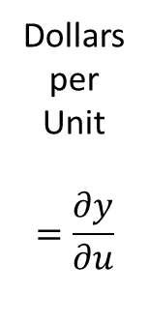
Demand and Supply
Total Benefits and Total Costs
Marginal Benefits and Marginal Costs
Total
Benefit
Dollars
per
Unit
$$=\frac{∂y}{∂u}$$
Marginal
Costs
Dollars
= $Y$
Total
Costs
Marginal
Benefit
Units
Units

Slide 11
Market for Pollution
Total Benefits and Total Costs
Marginal Benefits and Marginal Costs
Total
Benefit
Dollars
per
Unit
$$=\frac{∂y}{∂u}$$
Marginal
Costs
Dollars
= $Y$
Total
Costs
Marginal
Benefit
Units of pollution abatement
Units of pollution abatement

Slide 12
Market for Pollution
Total Benefits and Total Costs
Marginal Benefits and Marginal Costs
Total
Benefit
Dollars
per
Unit
$$=\frac{∂y}{∂u}$$
Marginal
Costs
Dollars
= $Y$
Total
Costs
Marginal
Benefit
More pollution
Less pollution
Units of pollution abatement
Units of pollution abatement

Slide 13
Market for Pollution
Total Benefits and Total Costs
Marginal Benefits and Marginal Costs
Total
Benefit
Dollars
per
Unit
$$=\frac{∂y}{∂u}$$
Marginal
Costs
Dollars
= $Y$
Total
Costs
Marginal
Benefit
Units of pollution abatement
Units of pollution abatement

Slide 14
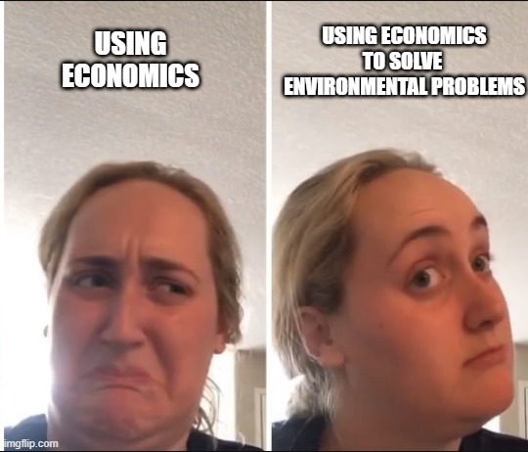
Market for Pollution
A “market” for “pollution”…
There are benefits from decreasing pollution
Benefits are decreasing in the
amount of pollution abatement
There are costs of decreasing pollution
Costs are increasing in the
amount of pollution abatement

Slide 15
Lecture 2b: Why Markets Fail
Prof. Theising
Environmental Economics Econ 4075

Slide 16
We all have that friend
“Anyone who has taken Econ 101 knows…”
If someone starts a sentence with this, anything that follows is likely to be an incomplete picture of whatever the topic is.

Slide 17
We all have that friend
“Anyone who has taken Econ 101 knows…”
If someone starts a sentence with this, anything that follows is likely to be an incomplete picture of whatever the topic is.
Markets are great! But they are not perfect.

Slide 18
We all have that friend
“Anyone who has taken Econ 101 knows…”
If someone starts a sentence with this, anything that follows is likely to be an incomplete picture of whatever the topic is.
Markets are great! But they are not perfect.
Markets provide powerful incentives for innovation, production, price discovery, a general move towards economic efficiency, and many more desirable outcomes that improve the wellbeing of societies (note, “wellbeing” is a general term that is used to describe more than just income!)

Slide 19
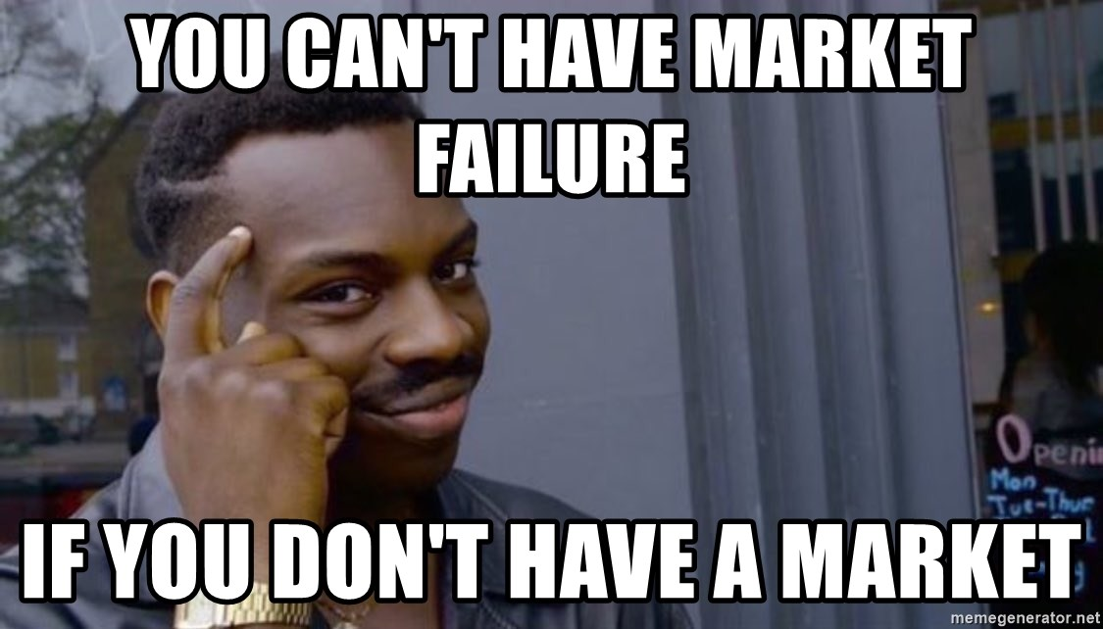
So, “free markets” are bad?

Slide 20
An Example: The Market for Plastic Bags
Value
Private
Marginal
Benefit
# of Bags

Slide 21
An Example: The Market for Plastic Bags
Value
Private
Marginal
Costs
Private
Marginal
Benefit
# of Bags

Slide 22

An Example: The Market for Plastic Bags
Value
Private
Marginal
Costs
Private
Marginal
Benefit
$$b^{∗}$$
# of Bags

Slide 23
An Example: The Market for Plastic Bags
What’s missing?
Value
Private
Marginal
Costs
Private
Marginal
Benefit
$$b^{∗}$$
# of Bags

Slide 24
An Example: The Market for Plastic Bags
What’s missing?
The external marginal cost
Value
Private
Marginal
Costs
Private
Marginal
Benefit
$$b^{∗}$$
# of Bags

Slide 25
An Example: The Market for Plastic Bags
What’s missing?
The external marginal cost
Value
Private
Marginal
Costs
Private
Marginal
Benefit
External
Marginal
Costs
$$b^{∗}$$
# of Bags

Slide 26

An Example: The Market for Plastic Bags
What’s missing?
The external marginal cost
Adding the external cost to the private recovers the (true) social marginal cost
Value
Social
Marginal
Costs
Private
Marginal
Costs
Private
Marginal
Benefit
External
Marginal
Costs
$$b^{∗}$$
# of Bags

Slide 27


An Example: The Market for Plastic Bags
What’s missing?
The external marginal cost
Adding the external cost to the private recovers the (true) social marginal cost
The socially optimal number of bags is fewer than the private
Value
Social
Marginal
Costs
Private
Marginal
Costs
Private
Marginal
Benefit
External
Marginal
Costs
$$b_{s}^{∗}$$
$$b_{p}^{∗}$$
# of Bags

Slide 28
An Example: The Market for Plastic Bags
What’s missing?
The external marginal cost
Adding the external cost to the private recovers the (true) social marginal cost
The socially optimal number of bags is fewer than the private
What is a possible fix?
Value
Social
Marginal
Costs
Private
Marginal
Costs
Private
Marginal
Benefit
External
Marginal
Costs
$$b_{s}^{∗}$$
$$b_{p}^{∗}$$
# of Bags

Slide 29

An Example: The Market for Plastic Bags
What’s missing?
The external marginal cost
Adding the external cost to the private recovers the (true) social marginal cost
The socially optimal number of bags is fewer than the private. The private market overprovides bags
What is a possible fix?
A tax equal to the external marginal cost
Value
Social
Marginal
Costs
Private
Marginal
Costs
Private
Marginal
Benefit
External
Marginal
Costs
$$tax$$
$$b_{s}^{∗}$$
$$b_{p}^{∗}$$
# of Bags

Slide 30



An Example: The Market for Basic Research
Basic research: scientific research largely driven by curiosity, without an immediate “real-world application” in mind.
Here: the externality is a “good”.
The private market typically underprovides basic research.
A government subsidy (often in the form of grants) can help correct this market failure
In this context, is the external marginal benefit actually fixed (flat)?
Try drawing an example of what you think external marginal benefits are
Value
Private
Marginal
Costs
Social
Marginal
Benefit
Private
Marginal
Benefit
External
Marginal
Benefit
$$subsidy$$
$$e_{s}^{∗}$$
$$e_{p}^{∗}$$
Time spent on research

Slide 31
Example from Game Theory: a Static Externality
Person B
Mouth Shut
Tattle
Mouth Shut
A: 3 years in jail
B: 3 years in jail
A: 10 years in jail
B: 2 years in jail
Person A
A: 2 years in jail
B: 10 years in jail
A: 8 years in jail
B: 8 years in jail
Tattle

Slide 32
Another Example from Game Theory: Dynamic Externalities
Let’s play a game…
Everybody is going to pick a number between 0 and 100, and write it on a piece of paper. (But read the rules below before choosing!)
The person whose chosen number, X, is closest to 75% of the class average gets X/20 extra credit points on the midterm.
E.g. if the class’s average number is 80, the person who guesses closest to 60 wins 3 extra credit points (60/20)
Any ties determined by coin flip, or drawing straws

Slide 33
Game #2: Public good provision
Note: the winning player will be randomly selected after you submit your bids. (This is called incentive compatibility: it means it’s in your interest to play for real ☺)
In this game, you are endowed with 5 units of “labor”
You can allocate this time, in one unit increments, either to your “private” use or contribute it to the “public project”.
You start with 0 extra credit points earned.
For every hour of labor donated by the class to the public project, you can add 0.05 extra credit points to your score on the midterm exam
E.g. there are ~45 students. If everyone contributes 5 hours, you can add up to 11.25 extra credit points to your score on the midterm
BUT: your labor is privately costly… for every unit of labor that you contribute to the public project, subtract 2 extra credit points from your midterm exam. (Yes, you could go negative here…)
On your piece of paper, write down the # of labor units you contribute to public project.
(This should be an integer between 0 and 5)

Slide 34
Market Failures
There are many different types or root causes of market failures. Think of some examples under each of these categories.
Information Asymmetries
One party in a transaction knows more than the other
Market Structure/Power
One party can influence the market equilibrium
Public Goods
Nonrival and nonexcludable
Externalities
Private actions have unintended effects

Slide 35
Resources for Learning R
(and other useful tools for data science)
Note: These are some references for those who are eager to start using R or anxious about the prospect of coding. Not required!
Introduction to R for Economists
Great video series (with links and replication code!) for just getting started (i.e., if you’ve never even installed R before)
He has many other advanced videos (masters, Phd, etc.) that are well done. With replication code and data.
Data Science for Economists
PhD-level data science course, but very accessible once you learn the basics of R.
Lecture 4 specifically covers R. But the whole course covers the necessary pieces for building a reliable and efficient data science ecosystem.
Having some experience programming experience is useful, but not required.

